Slide 1
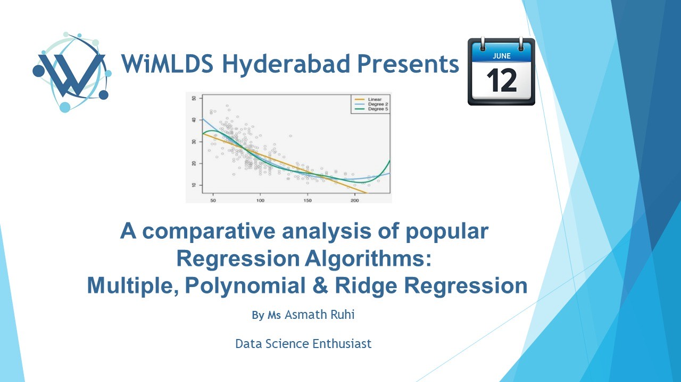

Slide 2
About me
I’m an IBM certified Data Scientist and an MBA graduate, with a strong statistical and research background. I have skills in Python, SQL and Tableau.
My research on the Indian Stock Market is published in the International Journal of Management, Technology & Engineering (IJMTE).
I enjoy technical writing and building creative Data science projects utilizing open data.
You can find me on:
LinkedIn: https://www.linkedin.com/in/ruhii/
Medium: https://ruhi-i.medium.com/

Slide 3

A Comparative Analysis of Regression Algorithms: Multiple, Polynomial & Ridge
By Asmath Ruhi

Slide 4
What is Regression?
Regression is a statistical technique that expresses the relationship between two or more variables, in the form of an algebraic equation, which not only reflects the strength and direction of their relationship but is also used to estimate the value of the dependent variable.
The variable whose value is to be predicted is called the Dependent/Response/Target Variable.
The variables used to predict the target variable are called Independent variables/Features/Predictors/Regressors.
When there are multiple independent variables, it is called Multiple Linear Regression.
For example, Level of Education → Income
Level of Advertising → Sales

Slide 5
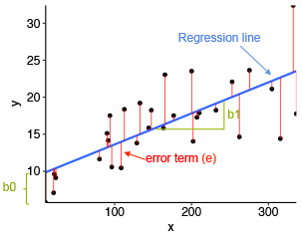

The Regression Equation
$\hat{y}=b_{0}+b_{1}χ_{1}+…+b_{n}x_{n}$ $+$ $ε$
where, $b_{0}$ = Bias/Intercept
${ b}_{1}$ = Slope/ Weight of $χ_{1}$
$χ_{1}$ = Independent Variable/Feature
$\hat{y}$ = Dependent Variable/Target
$ε$ = Error
$ε$
$ε$

Slide 6
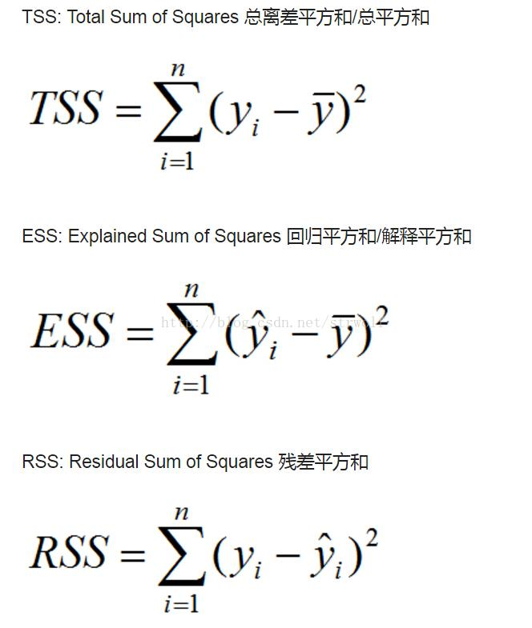
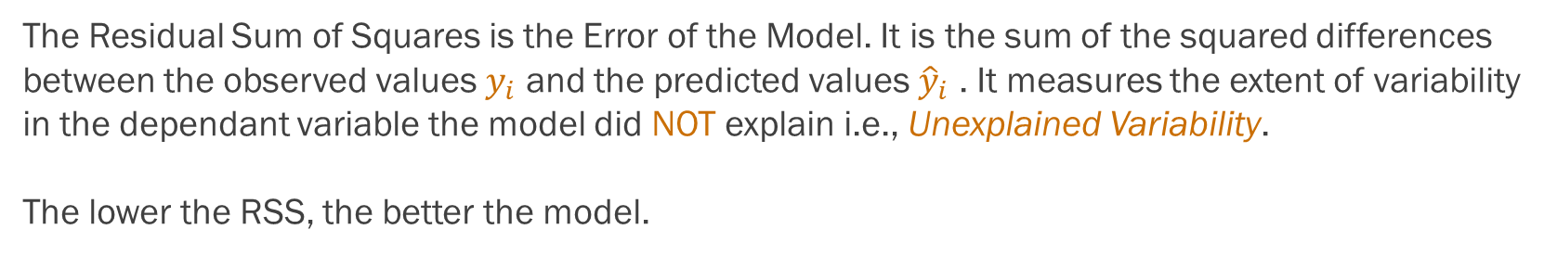
Residual Sum of Squares: RSS
The Residual Sum of Squares is the Error of the Model. It is the sum of the squared differences between the observed values $y_{i}$ and the predicted values ${\hat{y}}_{i}$ . It measures the extent of variability in the dependant variable the model did NOT explain i.e., Unexplained Variability.
The lower the RSS, the better the model.

Slide 7
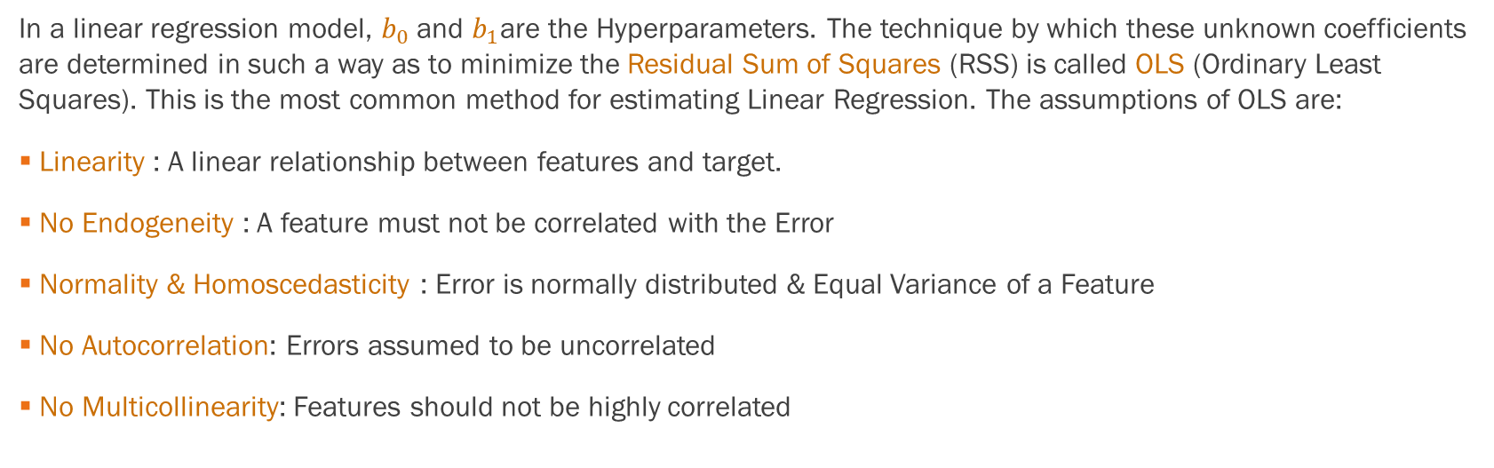
OLS: Ordinary Least Squares
In a linear regression model, $b_{0}$ and $b_{1}$are the Hyperparameters. The technique by which these unknown coefficients are determined in such a way as to minimize the Residual Sum of Squares (RSS) is called OLS (Ordinary Least Squares). This is the most common method for estimating Linear Regression. The assumptions of OLS are:
Linearity : A linear relationship between features and target.
No Endogeneity : A feature must not be correlated with the Error
Normality & Homoscedasticity : Error is normally distributed & Equal Variance of a Feature
No Autocorrelation: Errors assumed to be uncorrelated
No Multicollinearity: Features should not be highly correlated

Slide 8
Regression Algorithm in ML
Regression is one of the most common methods for Predictive Modeling, used for predicting a continuous value. It is used in Supervised Machine Learning and is the building block for most Machine Learning algorithms.
Even Neural Networks in Deep Learning are fundamentally based on this concept, except that they add non-linearities to model more complex relationships.
A popular Data Science Library which has the Regression Algorithm built in, is Sklearn.

Slide 9

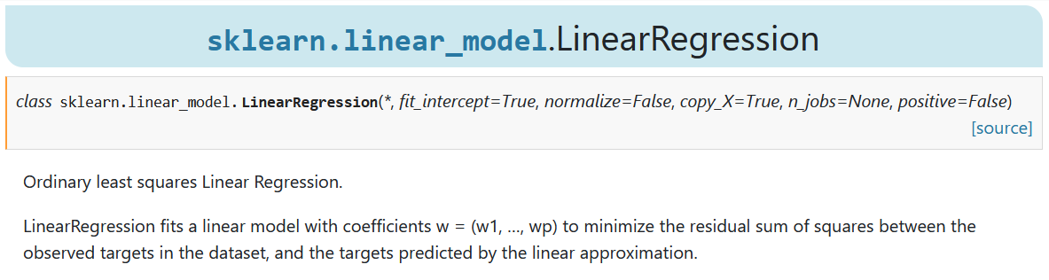
Linear Regression
In our practical example, we will be using Sklearns Linear Regression functionality, which uses OLS for finding the best fit.
We will also be using Sklearn for standardizing the data, splitting the data into train and test sets, and calculating the model accuracy.

Slide 10
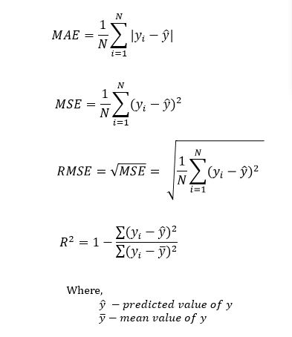
Accuracy Metrics for Model Evaluation
Accuracy Metrics show how accurate our model is in predicting values. The most popular metrics, which we will be using in our example are:
Mean Absolute Error (MAE)
Root Mean Square Error (RMSE)
It is the sum of the absolute difference between actual & predicted values, over the number of observations.
It is the square root of the sum of squared differences between actual & predicted values, over the number of observations. It is the most popular metric for comparing different regression models.

Slide 11

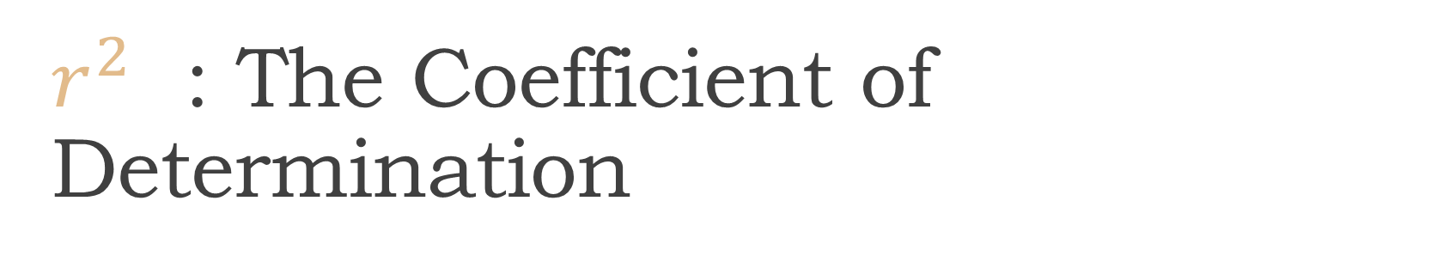
$r^{2}$ : The Coefficient of Determination
$r^{2}$ indicates the proportion of the variance in the dependant variable that is explained by the model. It measures how well the model fits the data. It is not an error, but an accuracy metric.
It is a relative measure, with values ranging between 0 and 1.
The higher the $r^{2}$ , the better the model.

Slide 12
Different Types of Regression
The Regression Algorithm discussed so far, models only Linear Relationships i.e., a change in the independent variable, brings about a proportionate change in the dependent variable.
However, variables don’t always have a Linear Relation. In many real-world cases, the OLS assumptions aren’t met. In order to overcome this, there are different types of Regression, such as:
Polynomial Regression
Ridge Regression

Slide 13
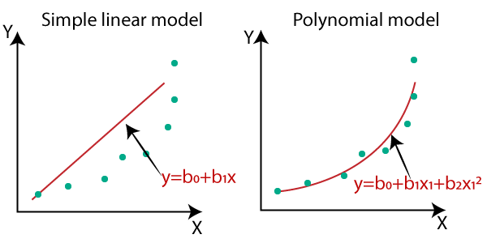
Polynomial Regression
Polynomial Regression is a special case of Multiple Linear Regression, where the relationship between the features and target is modeled as an nth degree polynomial.
This type of Regression is used when there is a curvilinear relationship between features and targets, and a straight line can no longer capture this relationship.
A Polynomial is the sum of several algebraic terms that contain different powers of the same variable(s). We can choose a quadratic, cubic ……or any degree of polynomial suitable for our data.

Slide 14
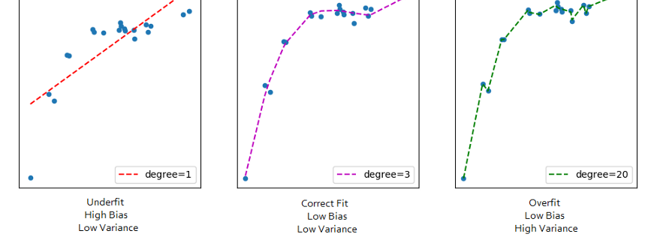
Bias-Variance Tradeoff in Polynomial Regression
A very high degree of polynomial will capture all the noise, leading to high variance and overfitting.
A linear regression line will not capture the data points and lead to high bias and underfitting.

Slide 15
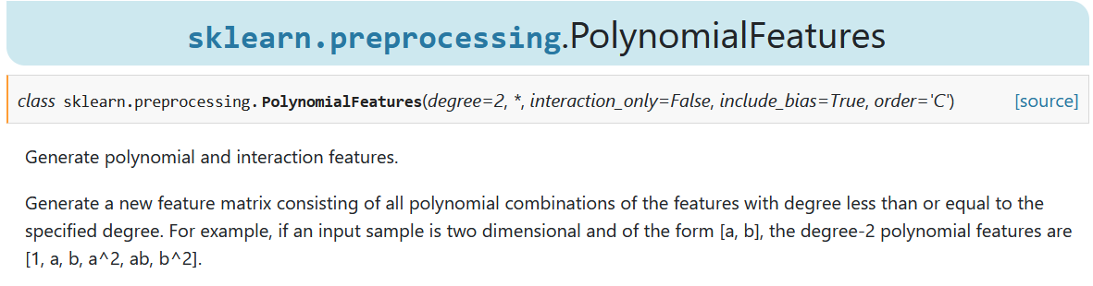
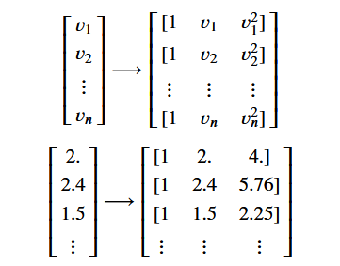
Polynomial Features

Slide 16


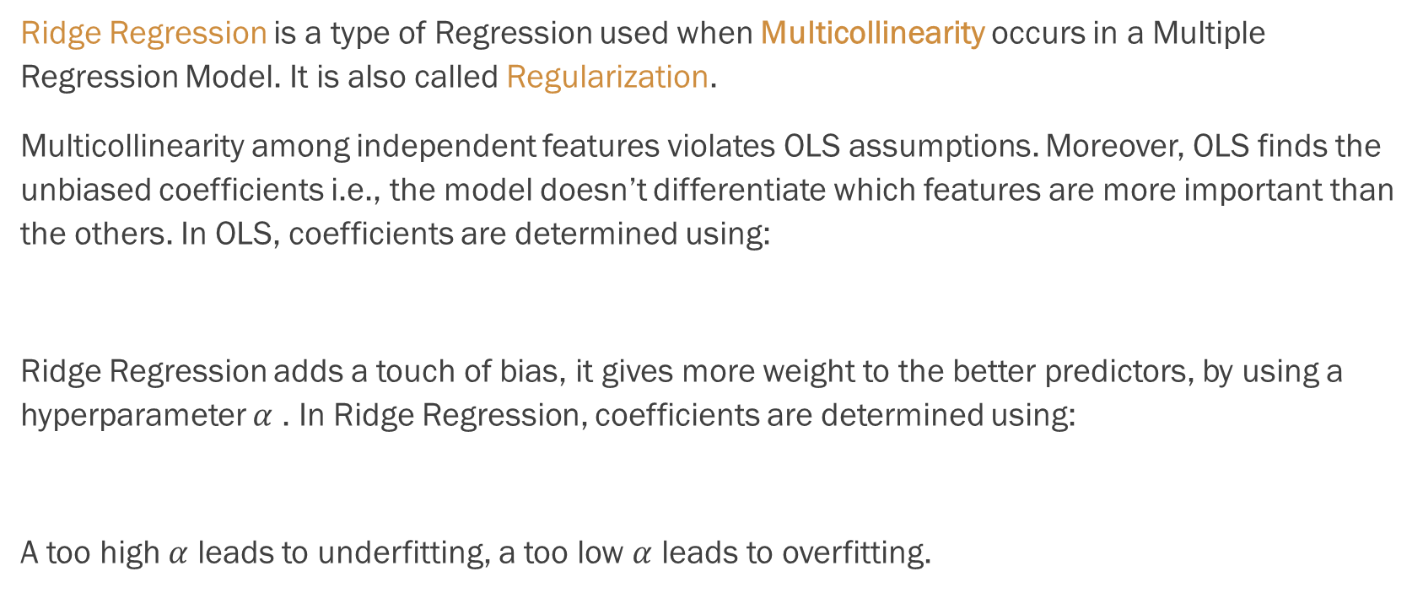
Ridge Regression
Ridge Regression is a type of Regression used when Multicollinearity occurs in a Multiple Regression Model. It is also called Regularization.
Multicollinearity among independent features violates OLS assumptions. Moreover, OLS finds the unbiased coefficients i.e., the model doesn’t differentiate which features are more important than the others. In OLS, coefficients are determined using:
Ridge Regression adds a touch of bias, it gives more weight to the better predictors, by using a hyperparameter $α$ . In Ridge Regression, coefficients are determined using:
A too high $α$ leads to underfitting, a too low $α$ leads to overfitting.

Slide 17
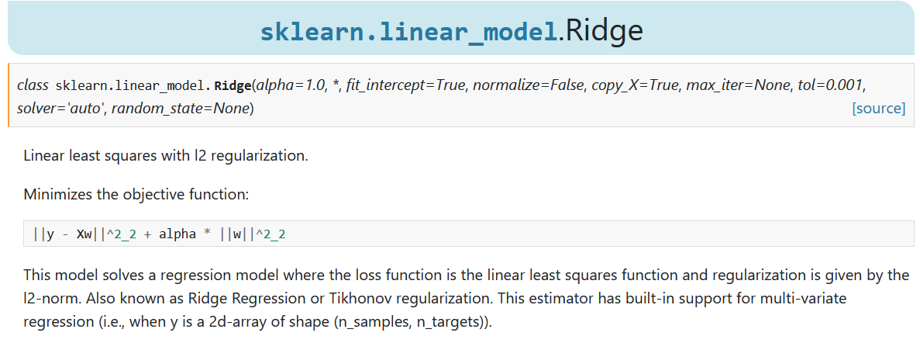
Ridge Regression
Ridge Regression is commonly used with higher order Polynomial Regression. It minimizes the standard errors to avoid overfitting.

Slide 18
Thank You
Hope you enjoyed this session

